Slide 1
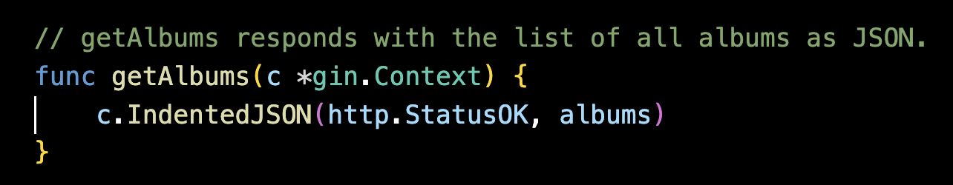
Learning the Go Code
Handler Function 1: getAlbums
The function body:
c.IndentedJSON(http.StatusOK, albums)
This single line does a lot:
Takes the albums slice (our data)
Converts it to JSON format
Sends it back with a 200 OK status code
The "Indented" part means it formats the JSON nicely with spacing (easier to read)
0
What is gin.Context? Think of it as a "toolbox" that Gin gives to every handler function. It contains:
Information about the incoming request (headers, parameters, body)
Methods to send responses back
Other utilities for handling the request

Slide 2
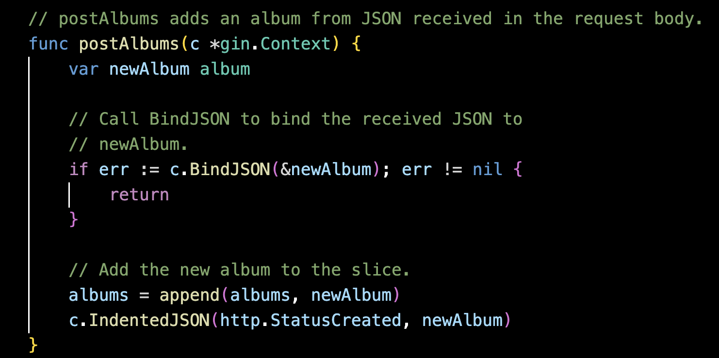
Learning the Go Code
Handler Function 2: postAlbums
1. What is BindJSON doing?
It's taking the JSON from the request body and converting it into our Go album struct. So if someone sends:
json
{"id": "4", "title": "New Album", "artist": "Someone", "price": 29.99}
BindJSON transforms that into a Go struct that our program can work with.
The function body:
c.IndentedJSON(http.StatusCreated, newAlbum)
Sends back the newly created album as JSON with a 201 Created status code (which is the proper HTTP status for "successfully created a new resource")

Slide 3

Learning the Go Code
2. Data flow
for POST request:
JSON arrives (text over the network):
json
{"id": "4", "title": "Kind of Blue", "artist": "Miles Davis", "price": 24.99}
BindJSON transforms it into a Go struct:
go
album{ID: "4", Title: "Kind of Blue", Artist: "Miles Davis", Price: 24.99}
Now it's a Go object in memory that our program can work with
Stored in the slice: albums = append(albums, newAlbum)
Sent back as JSON: c.IndentedJSON() converts the struct back to JSON text
json
{"id": "4", "title": "Kind of Blue", "artist": "Miles Davis", "price": 24.99}
The pattern: JSON (text) → Go struct (program data) → JSON (text)
1. The HTTP concepts
— requests, responses, status codes
GET vs POST:
GET = "retrieve/read data" - doesn't change anything, just fetches
POST = "create new data" - adds something new to the server
Status codes communicate what happened:
200 OK = "Success! Here's your data"
201 Created = "Success! I created the new thing you asked for"
404 Not Found = "I couldn't find what you requested"

Slide 4
II. What is a Virtual Machine (VM)?
A Virtual Machine (VM) is a software-based computer that runs inside a physical server.
It has its own operating system, CPU, memory, and storage.
On AWS, EC2 is a virtual machine provided in the cloud.
Running a program on a VM is different from running it locally because:
This allows scalability and remote access but adds setup complexity.
It runs on remote hardware.
You access it through the internet.
You must manage security, networking, and access.

Slide 5
III. SSH, Security Groups, and IP Addresses
SSH is used to securely connect to a remote machine.
AWS uses Security Groups as virtual firewalls.
I had to allow SSH (port 22) from my own IP address.
If my IP address changes (e.g., different Wi-Fi or VPN), I must update the security group to allow the new IP.
This protects the server from unauthorized access.

